Slide 1
Lab #1 Spice Simulation
作業繳交截止日期: May 12, 2025, 23:59 (2 weeks)
(上傳E3數位平台繳交)
24 hours after the deadline: 20% penalty
48 hours after the deadline: 50% penalty
No submissions accepted after 48 hours
檔案：
VLSI_Lab1_學號.pdf (VLSI_ Lab1_112345678.pdf) 請完成Word檔並將檔案轉成PDF格式
Lab1_學號.sp (Lab1_112345678.sp)

Slide 2
Lab #1 Spice Simulation
D-Flip-Flop (DFF) Timing Analysis and Setup Time Estimation using NGSPICE
Objective:
The objective of this assignment is to simulate a D-Flip-Flop (DFF) circuit using NGSPICE to analyze the timing relationship between the data input (D) and clock (CLK), and to estimate the DFF's setup time under various process and voltage conditions.
Tool:
NGSPICE circuit simulator
Task:
DFF Simulation: Set up an NGSPICE simulation for a D-Flip-Flop.
Subcircuit name: “sky130_fd_sc_hd__dfxbp_1” (defined in “../../libs.ref/sky130_fd_sc_hd/spice/sky130_fd_sc_hd.spice”)
Timing Analysis: For each specified condition, perform simulations to measure the Tpcq by varying Tdc, where:
Tdc: is defined as the time difference between the data input (D) transition and the rising edge of the clock (CLK).
Tpcq: is defined as the time difference between the rising edge of the clock (CLK) and the resulting transition at the data output (Q).
Setup Time Estimation: Based on the Tdc vs Tpcq plots obtained from the simulations, estimate the setup time for the DFF under each condition. The setup time is typically the minimum time the data must be stable before the clock rising edge for reliable operation.
Condition Coverage: Perform the timing analysis and setup time estimation for a total of 15 different operating conditions. These conditions are a combination of:
5 Process Corners: Typical-Typical (tt), Fast-Fast (ff), Slow-Slow (ss), Fast-Slow (fs), Slow-Fast (sf)
3 Power Supply Voltages (VDD):1.8V (Nominal)1.98V (+10% of Nominal)1.62V (-10% of Nominal)
Cload: “sky130_fd_sc_hd__inv_1” (defined in “../../libs.ref/sky130_fd_sc_hd/spice/sky130_fd_sc_hd.spice”)
Deliverables:
NGSPICE netlist(s) used for the simulations.
A summary table listing the estimated setup time for each of the 15 conditions. A brief report summarizing your methodology and observations regarding the impact of process corners and VDD variations on the DFF's timing and setup time.

Slide 3
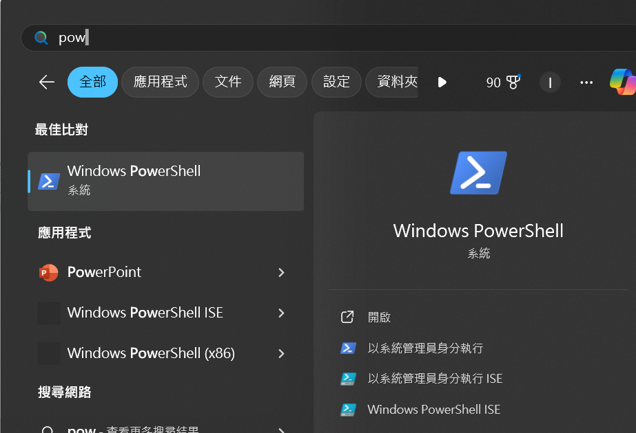
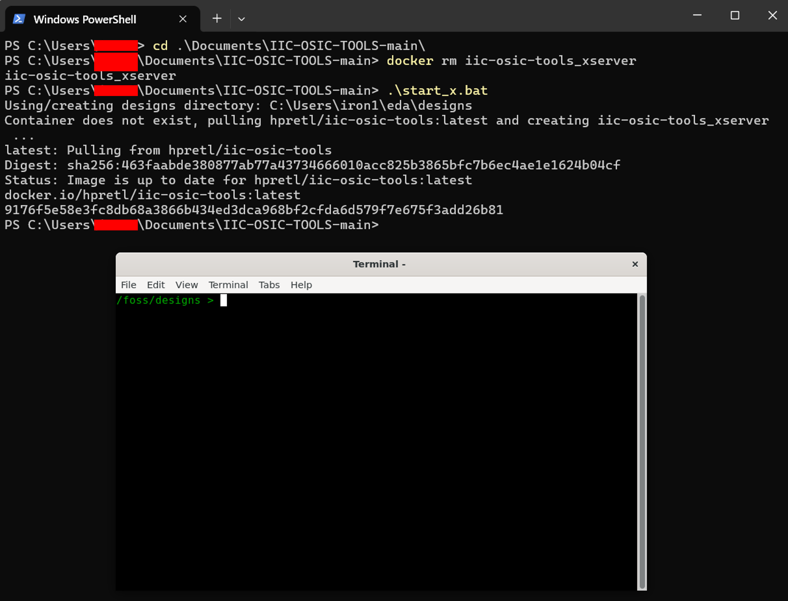
Tutorial (備註有說明)
2
1
Notes:
開啟powershell
Change folder到上次Github下載的資料夾下
先 docker rm iic-osic-tools_xserver
.\start_x.bat 啟動環境

Slide 4
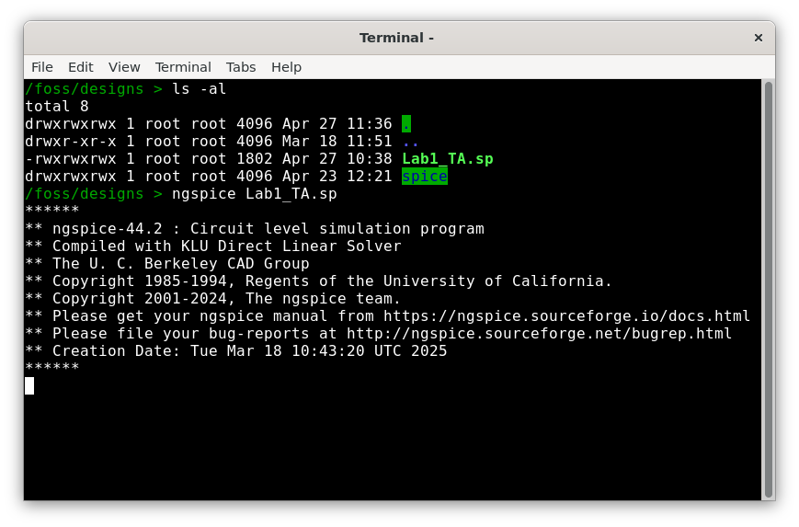
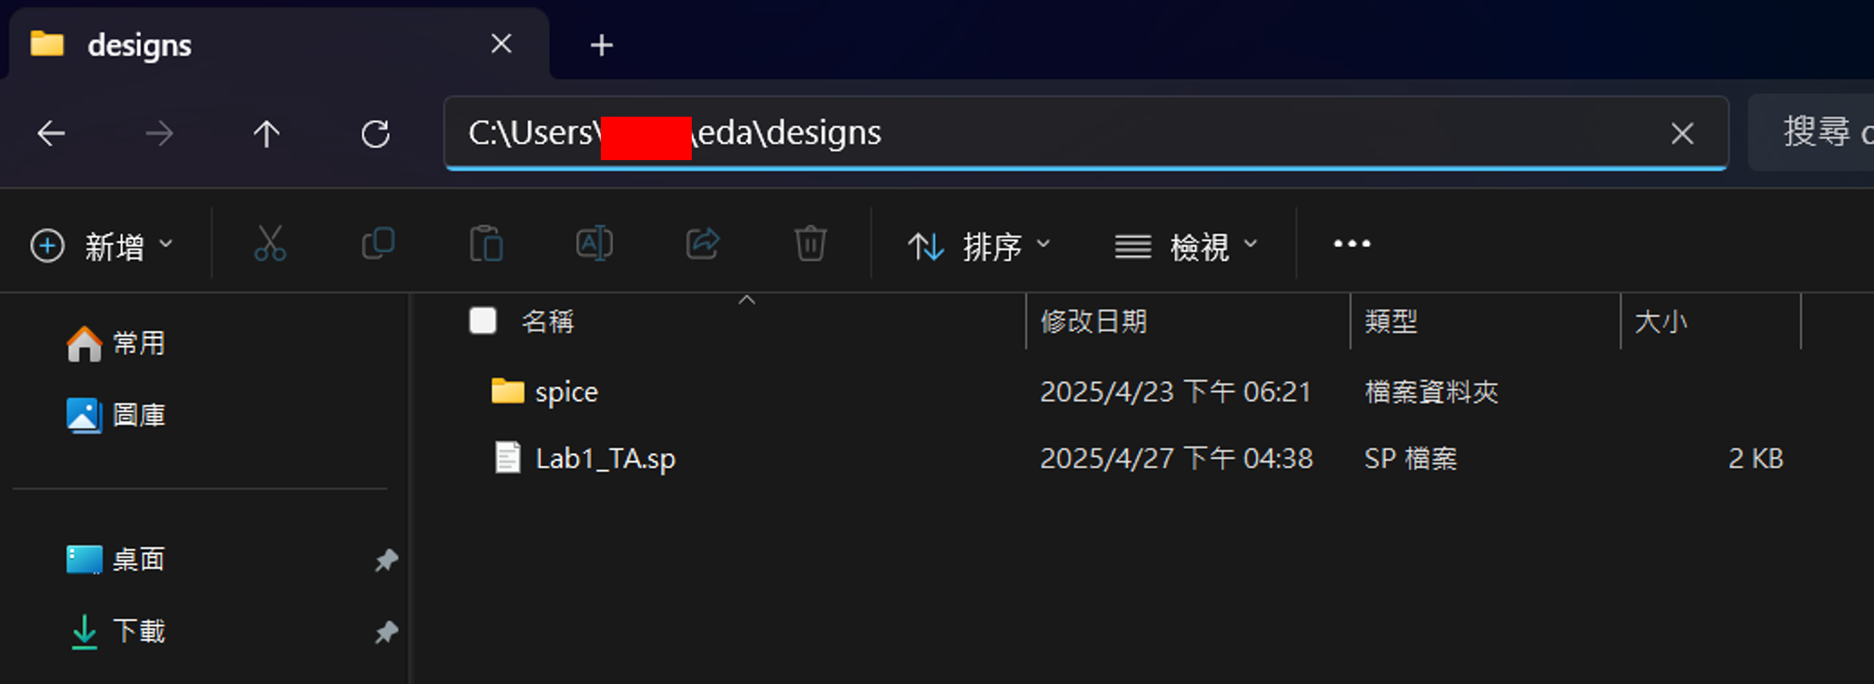
Tutorial (備註有說明)
2
1
Notes:
至C:\Users\your_username\eda\designs 將老師公告在E3的spice檔案下載並解壓縮複製到資料夾下
撰寫Spice檔
在Linux環境可以ls –al 看到資料夾已經有需要的檔案
使用ngspice Lab1_studentID.sp進行模擬

Slide 5
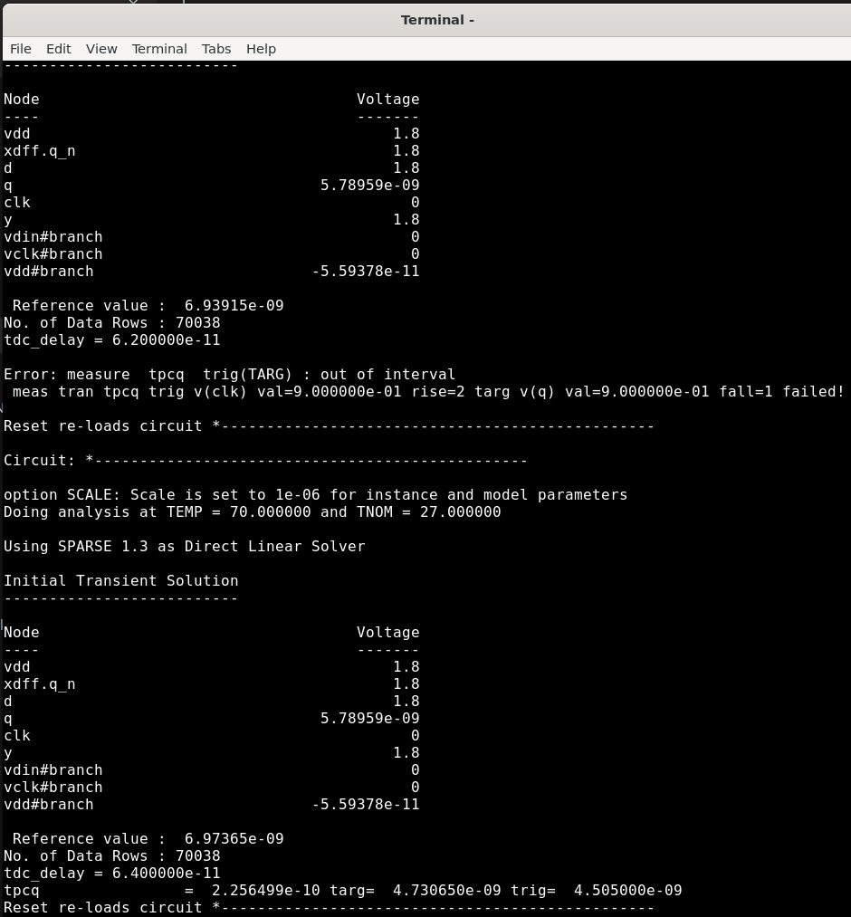
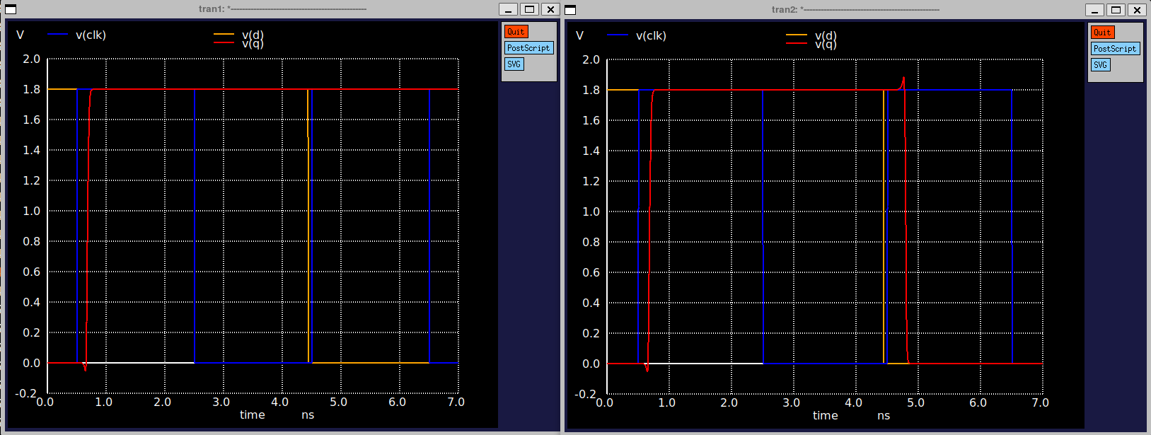
Tutorial (備註有說明)
Fail
Success
Notes:
至C:\Users\your_username\eda\designs 將老師公告在E3的spice檔案下載並解壓縮複製到資料夾下
這邊可以看到當Tdc足夠大的時候(D與clk距離越遠)，Q的值會改變。你需要截圖第一張Q有順利pass D值的圖
使用measure 可以量測到Tdc值是多少時Tpcq能順利量測到。你需要截圖上一個Tdc失敗但是下一個Tdc成功的圖

Slide 6
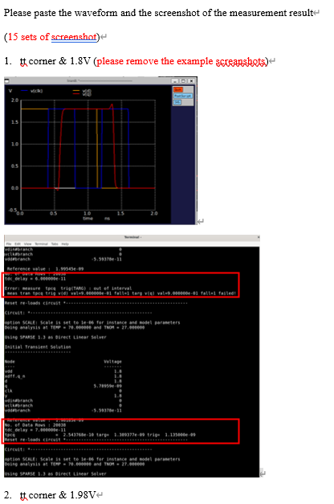
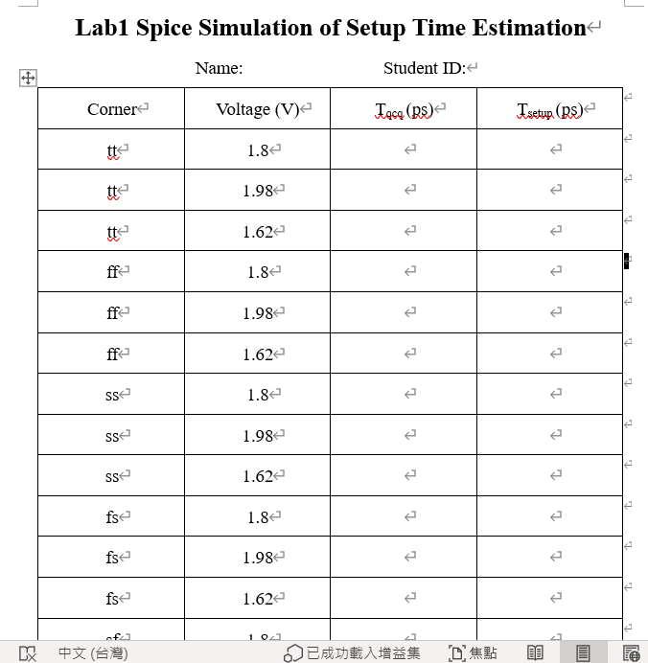
Tutorial (備註有說明)
Notes:
將量測量出來的值填入word檔以及貼上截圖

Slide 7
Tutorial (備註有說明)
在模擬中 clk 與 Din 的 rising/failing time 都設定為10ps
Sweep Tdc 的改變量為2ps
如果有問題請於E3討論區發問
建議同學可以去回顧老師線上上課的錄影(https://drive.google.com/drive/folders/1G7GUcM4EhRTh12nBjwicA8oEK4ZrtAXm?usp=drive_link)

